Slide 1

AI-Accelerated Cloud Service Onboarding
Platform Intelligence & Modernization Program
Prepared by: Scott Tully - Enterprise Hosting
Date: 12/03/25

Slide 2


The Current Challenge
It takes ~9 months to onboard a new cloud service.
This delay is driven by:
Fragmented Terraform modules
Multi-cloud ambiguity (Azure, GCP, VMC)
Late discovery of incompatibilities
Manual architecture mapping
Unclear placement decisions
Unsupported patterns identified too late
The impact:
Slower innovation
Platform rework
Unpredictable delivery timelines
Engineering frustration
Higher operational cost

Slide 3

Why AI, Why Now
AI lets us eliminate overhead, not add more process. With the right foundation, AI can:
Modernize and standardize Terraform
Pipeline Expectations
Recommend optimal deployment environments
Generate migration blueprints automatically
Platform Capabilities
Detect platform gaps early
Map designs to platform capabilities + security controls
Foundation: The "Platform Brain"
Terraform Modules
Approved Cloud Services
We build a Retrieval-Augmented Generation (RAG) corpus of:
Security & STIG
Terraform modules
Platform capabilities
Approved cloud services
Security/STIG requirements
Pipeline expectations
Architecture patterns
This becomes the “platform brain” AI uses to provide accurate, TD-specific guidance.

Slide 4
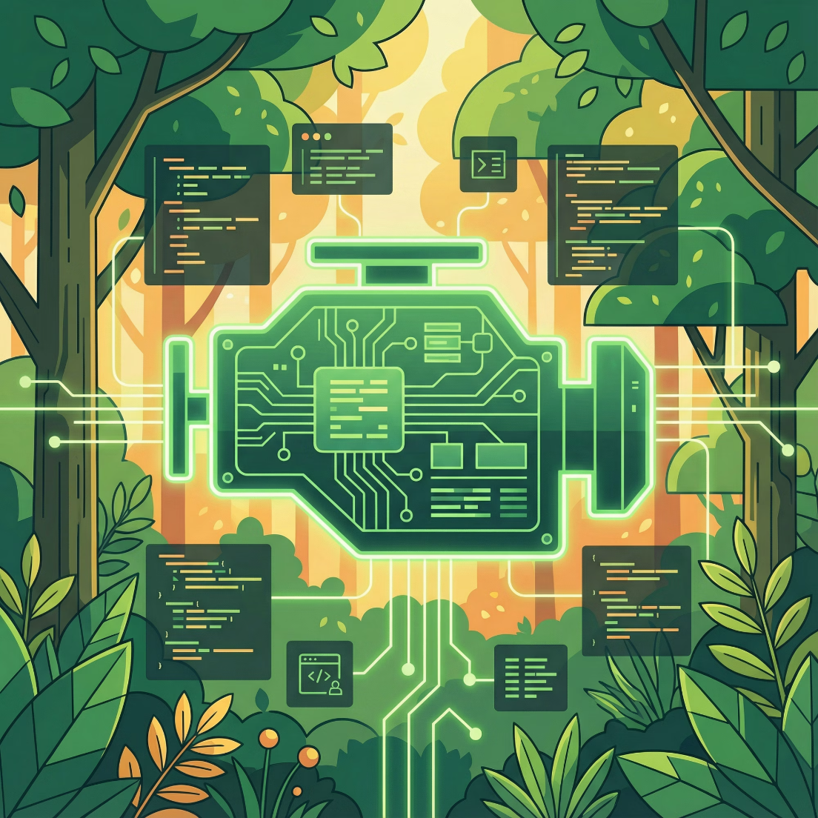

Driving Terraform Transformation: The AI Modernization Engine
AI automatically:
Conducts comprehensive analysis of all Terraform modules
Automates standardization of variable schemas and outputs
Rectifies inconsistencies proactively
Ensures consistent naming conventions and tagging policies
Identifies and proposes optimal module boundaries
Upgrades deprecated syntax and providers seamlessly
Generates comprehensive documentation automatically
Creates actionable modernization Pull Requests
Key Outcome
Delivers a highly consistent, predictable, and resilient DAG-driven Terraform ecosystem, ensuring operational excellence and accelerated deployments.

Slide 5

Pillar 2: Deployment Placement Advisor
Helps app teams answer: “Where should this workload run?”
Technical compatibility
Managed services available
Operator/CRD requirements
Security and STIG constraints
Latency and integration needs
Leadership financial preferences
Outcome: Eliminates months of analysis and misdirection.**

Slide 6
Pillar 3: Migration Blueprint Generator
Our AI-powered Migration Blueprint Generator revolutionizes cloud migration planning. App teams can simply upload existing on-premise diagrams or system designs, and our AI swiftly delivers comprehensive, optimized migration strategies, including:
Optimal Cloud Architectures
Comprehensive Analysis
Providing 2–3 validated cloud target architectures tailored to your specific workloads.
Detailed evaluation of tradeoffs, potential risks, and identified issues for each proposed architecture.
Strategic Platform Alternatives
Critical Stateful Migration
Evaluated options across leading cloud platforms (e.g., GKE, AKS, VMC) for optimal fit.
Essential considerations and strategies for migrating stateful applications and data effectively.
Dependency & Operator Constraints
Optimized Migration Sequencing
Identification of inter-system dependencies and critical operational limitations affecting migration.
Actionable, phased recommendations for seamless execution and transition.
Outcome: Gain architectural clarity and actionable blueprints in hours, not months, accelerating your migration timeline significantly.**

Slide 7

Pillar 4: Intelligent Platform Compatibility & Alignment
Our AI Validates App Designs Against:
Key Insights & Risks Uncovered:
Standardized Terraform configurations
Identification of incompatible cloud services
Defined platform capabilities and constraints
Gaps in required Terraform automation coverage
Mandatory security and STIG compliance controls
Critical STIG compliance deviations
Enterprise-approved cloud service catalogs
Potential integration conflicts and architectural clashes
Emergent platform risks and technical debt
Analysis of common migration blockers, informing strategic roadmap adjustments
Outcome
Achieve flawless deployments, eliminate costly late-stage rework, and empower strategic, data-driven platform evolution.

Slide 8



How It Fits Together
Inputs → AI Engine → Outputs
Inputs
AI Engine (with RAG corpus)
Outputs
System design documents
Terraform Modernization
Target architectures
On-prem architectural mapping
Placement Advisor
Migration plans
Requirements and constraints
Migration Blueprinting
Terraform module changes
Compatibility Mapping
Security/control mapping
Platform capability warnings
Roadmap signals

Slide 9
Implementation Roadmap (48 Weeks)
Phase 1 (0–10 weeks)
1
Discovery, Inventory & RAG Corpus
Build the unified RAG knowledge corpus
Scan Terraform repos
2
Phase 2 (10–22 weeks)
Capture platform capabilities and constraints
Terraform Modernization Engine
Consolidate STIG/security requirements
Automated refactor suggestions
Identify top gaps and friction points
Module alignment proposals
Modernization PRs and documentation
Phase 3 (22–36 weeks)
3
Architecture & Migration Intelligence
Deployment Placement Advisor
Migration Blueprint Generator
4
Phase 4 (36–48 weeks)
Compatibility Engine
Unified AI Assistant & Pilot Rollout
Single interface for app teams
Pilot with 3–5 LOBs
Telemetry and refinement

Slide 10

Expected Outcomes
The WAGs
40-70%
80%
reduction in onboarding time
reduction in TF inconsistencies
75%
30-40%
reduction in architecture “discovery cycles”
fewer platform support escalations
2-3x
Qualitative
Platform roadmap accuracy improves
Early clarity for app teams
Less friction and rework
Predictable cloud adoption
Better collaboration between platform + LOBs
Faster delivery without increased staffing

Slide 11
Executive Ask
We request approval to:
Launch the Platform Intelligence & Modernization Program
Begin Phase 1 discovery and build the RAG corpus
Assemble a working group (3–4 engineers)
Start Terraform modernization as the first accelerator
Establish the platform intelligence foundation
Meaningful acceleration begins within the first quarter.

Slide 12

Closing
Harnessing AI as our architecture and platform intelligence engine, we will shatter the current barriers to rapid cloud adoption and unlock unparalleled operational efficiency.
This isn't just an improvement; it's a revolution. We're slashing cloud onboarding from 9 months to 9 weeks, delivering unprecedented speed and value.
The outcome is a future-proof platform: inherently faster, relentlessly predictable, powerfully data-driven, and supremely resilient. This is the foundation for TD's accelerated innovation.

